Slide 1
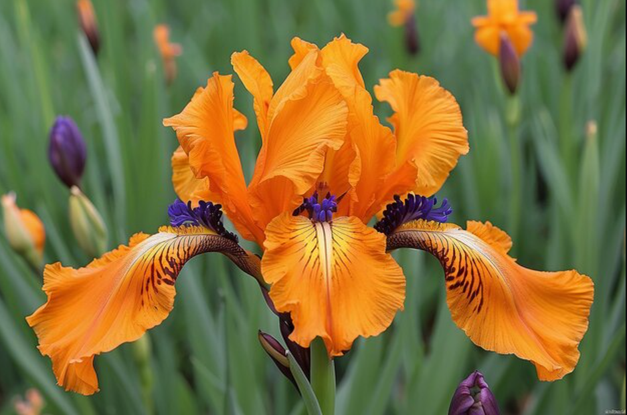
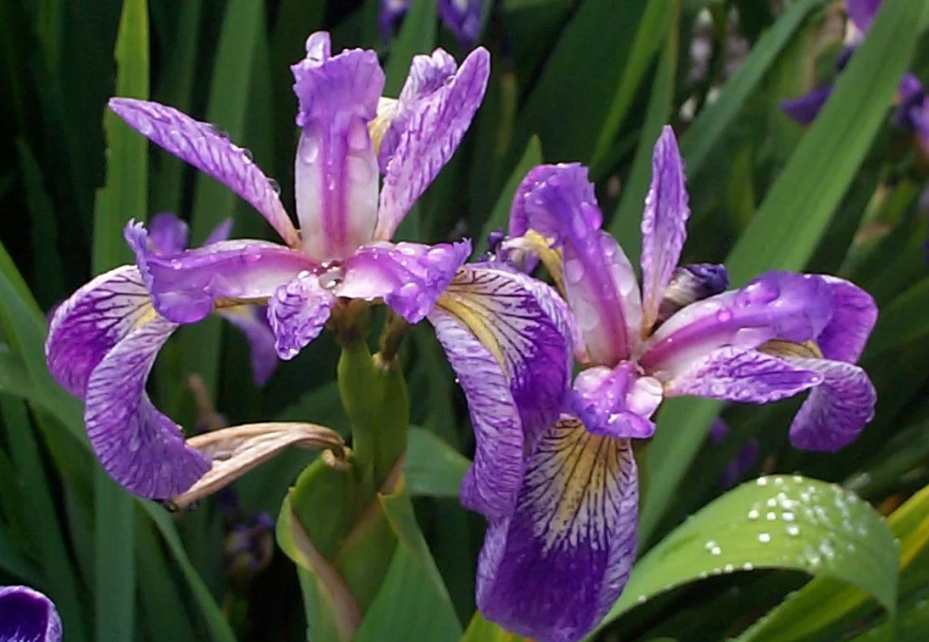
IRIS FLOWER CLASSIFICATION
Name : Sravanthi Komanduri
Student ID : CA/SE3/4442
Company : Code Alpha
Domain: Data Science
Duration : 25th Sep 25 - 25th Dec 25
@SravanthiKomanduri

Slide 2
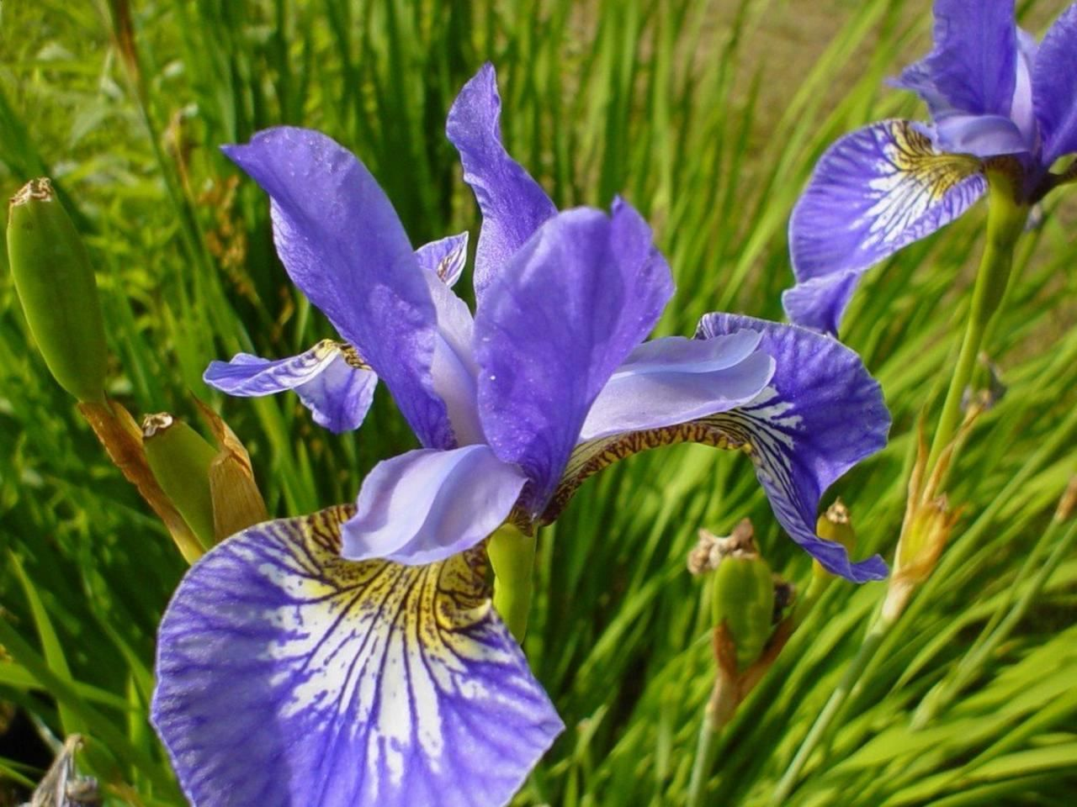
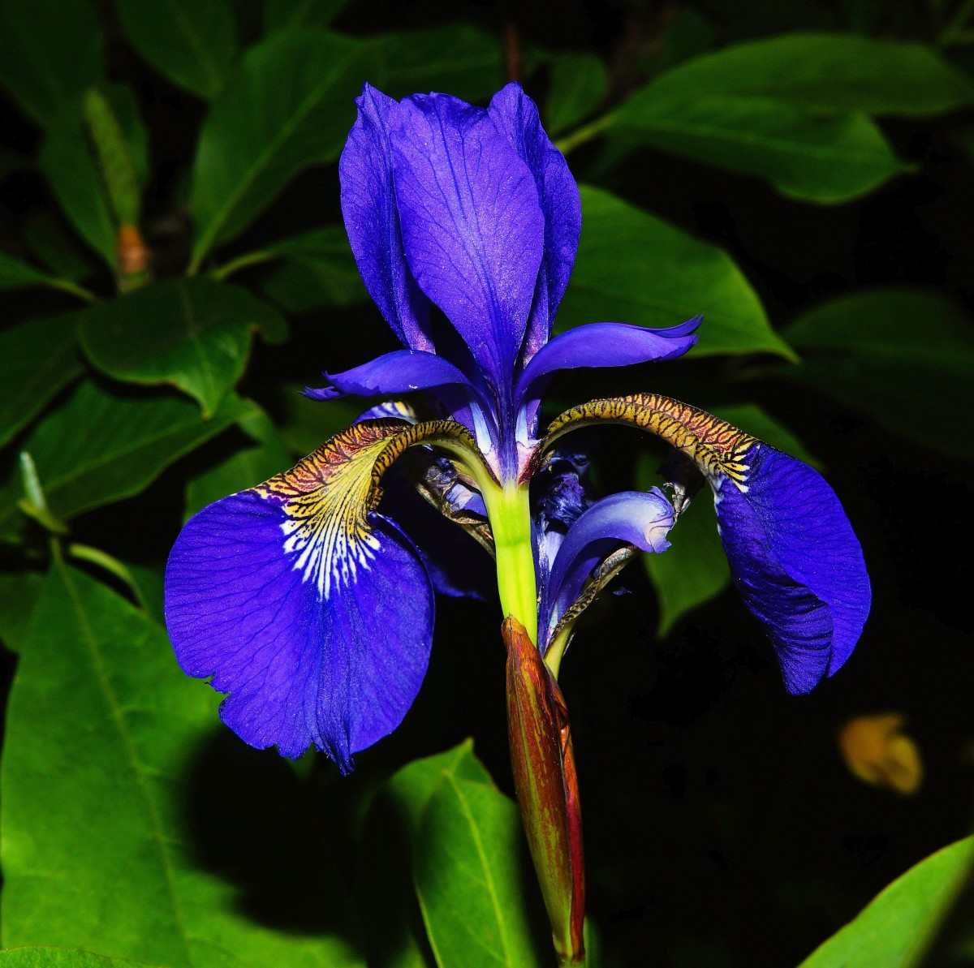
INTRODUCTION
The Iris flower Classification Model is a Supervised learning project that predicts iris species using petal and sepal measurements The dataset contains 150 samples of iris flower divided equally among three species Iris setosa , Iris Versicolor and Iris Virginica Each sample includes four features that describe the physical dimensions of the flower Sepal Length Sepal Width Petal Length Petal Width These measurements are used to classify the flower into their respective species
@SravanthiKomanduri

Slide 3

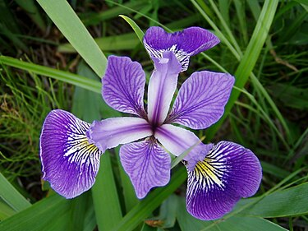
PROJECT OBJECTIVE
Train a machine learning model to classify the species based on these measurements
Evaluate the model ‘s Accuracy Performance using test data
@SravanthiKomanduri

Slide 4
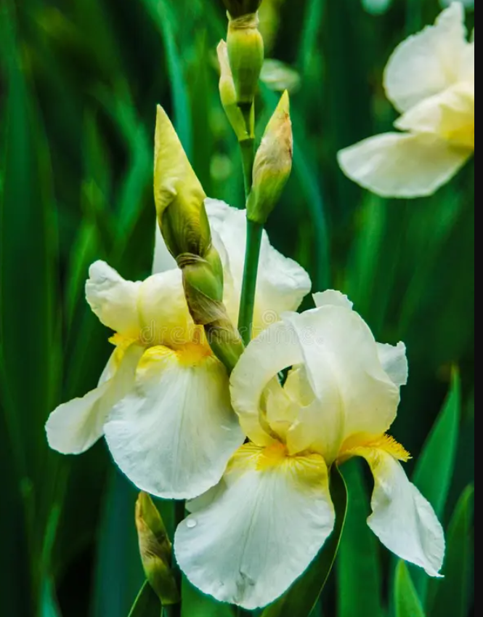
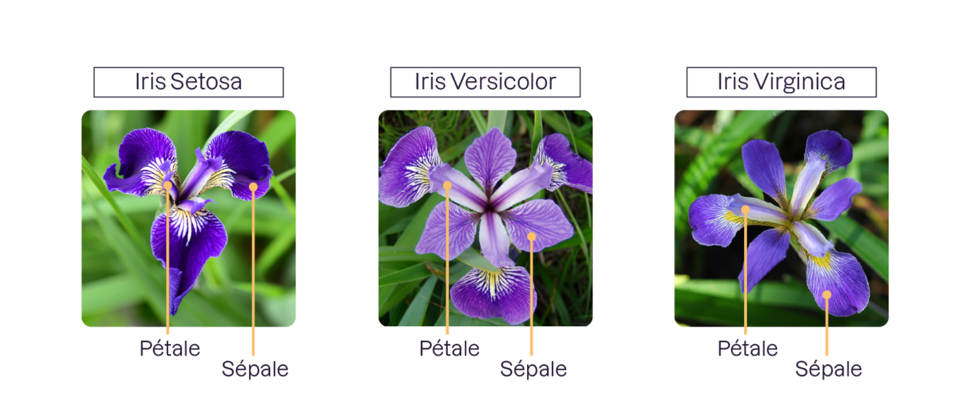
DATASET DETAILS
DATASET NAME : IRIS FLOWER DATASET
TOTAL SAMPLES : 150
CLASSES : SETOSA ,VERSICOLOR ,VIRGINICA
SOURCE : KAGGLE DATASET
EACH SAMPLE HAS 4 NUMERICAL FEATURES DESCRIBING FLOWER DIMENSIONS
@SravanthiKomanduri

Slide 5

PROJECT STEPS
2.Split the data into training and test sets
3.Scale features for better performance
1.Load and explore the IRIS Dataset
5. Predict and Evaluate Results
4.Train K- Nearest Neighbours (KNN) Classifier
6.Visualize Confusion matrix and scatter plots
@SravanthiKomanduri

Slide 6
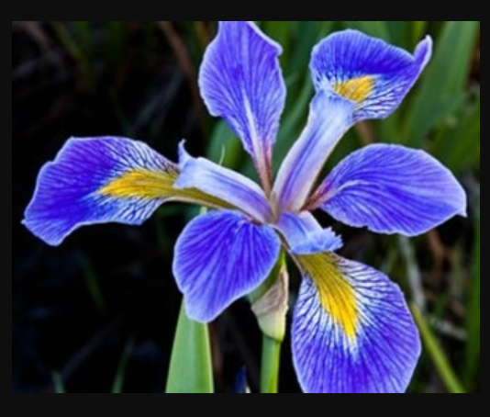
Model Used : K-Nearest Neighbour (KNN)
KNN is a simple and effective classification algorithm
It classifies new data points based on the majority label of their K nearest neighbour
K=3 was used
@SravanthiKomanduri

Slide 7
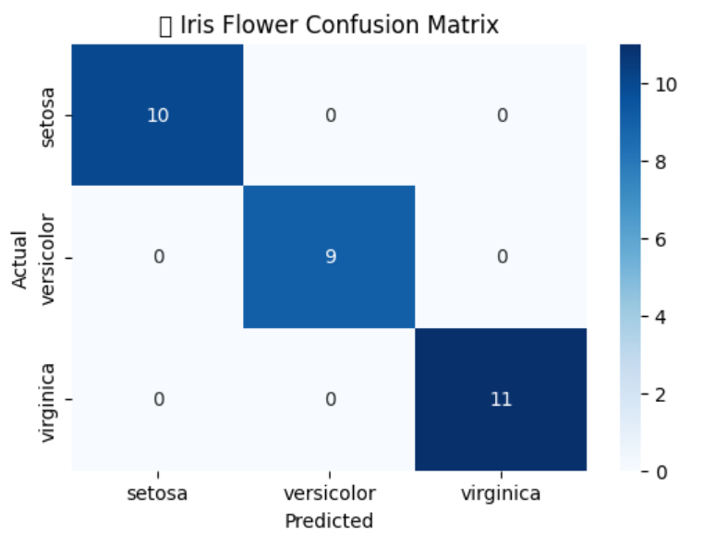
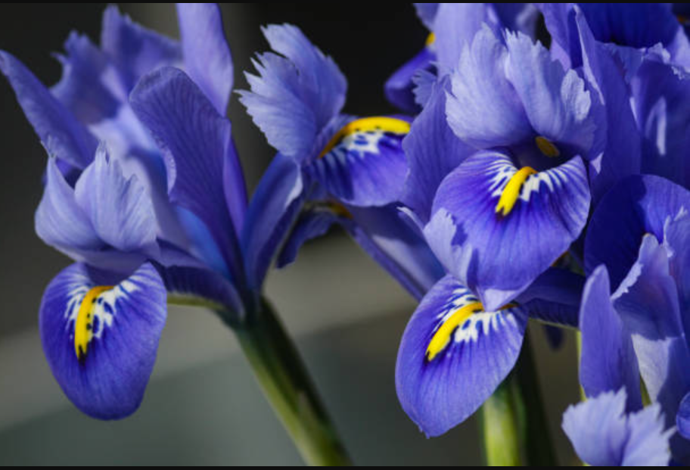
IRIS FLOWER CONFUSION MATRIX
The Confusion Matrix used to evaluate the performance of a classification model trained on the Iris dataset.
The rows represent Actual classes ,and the columns represent Predicted classes .
The Confusion matrix displays how accurately the model predicts each Iris Species .
All 10 setosa flowers are correctly classified
All 9 versicolor flowers are correctly classified
All 11 virginica flowers are correctly classified
This means the model achieved 100% accuracy on the test data, indicating on the test data that it perfectly distinguishes between the three species based on the feature used.
@SravanthiKomanduri

Slide 8
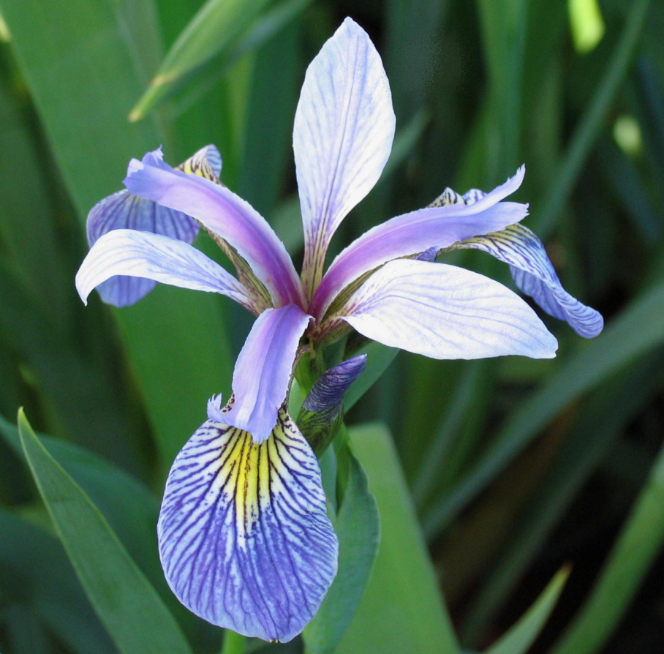
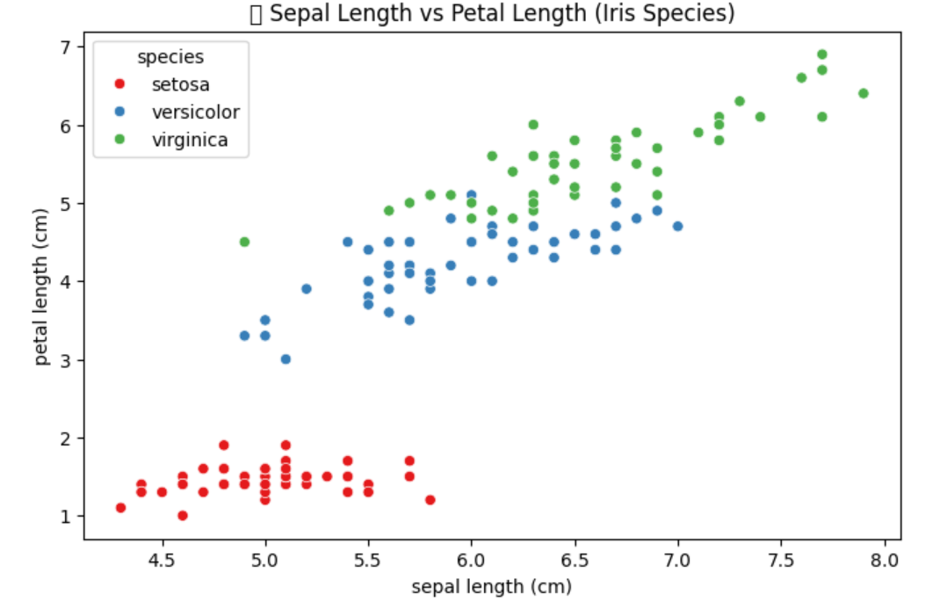
Scatter Plot Sepal Length vs Petal Length (Iris Species)
The Scatter plot visualization the relationship between Sepal Length (cm) and Petal Length (cm) for three Iris flower species
setosa (red) ,versicolor (blue) ,virginica (green)
The scatter plot represents how the sepal length and petal length vary across the three iris flower species
Each color corresponds to a specific species
We can clearly observe that
Iris setosa (red) has the smallest petal length and is distinctly separated from the other species
Iris Versicolor (blue) and Iris Virginica (green) overlap slightly but generally have longer petals as the sepal length increases
This visualization helps us understand that petal and sepal measurements can be strong indicators for classifying Iris species
@SravanthiKomanduri

Slide 9
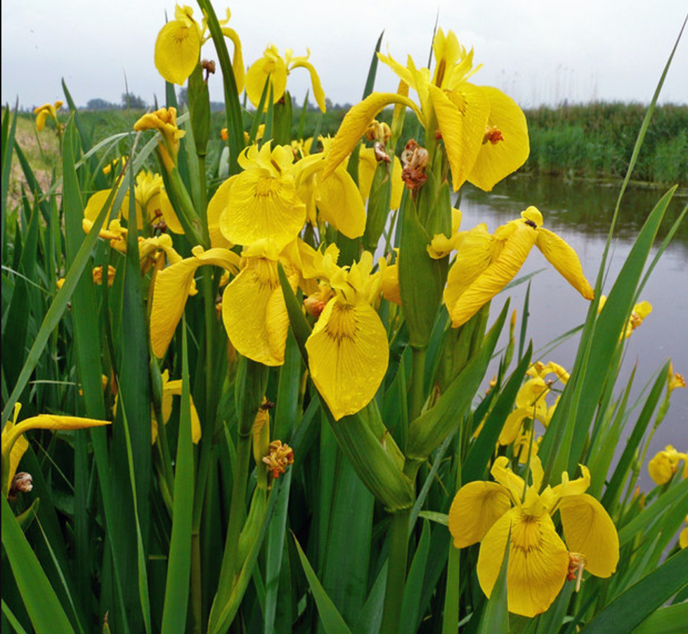
CONCLUSIONS
The Scatter plot visually separates the species based on petal and sepal measurements .
The Confusion Matrix confirms that the trained machine learning model accurately classified all iris species with 100% accuracy
KNN is a simple yet powerful algorithm for classification
High accuracy achieved with minimal preprocessing
@SravanthiKomanduri

Slide 10

THANK YOU
STAY CONNECTED
sravanthikomanduri21gmail.com
@SravanthiKomanduri

